Slide 1
Transparency between Research Methods and Results
Francis Oloo (Dr. rer. Nat)

Slide 2
Outline
Defining transparency in research
Linking methods to results
Reporting quantitative and qualitative results transparently

Slide 3
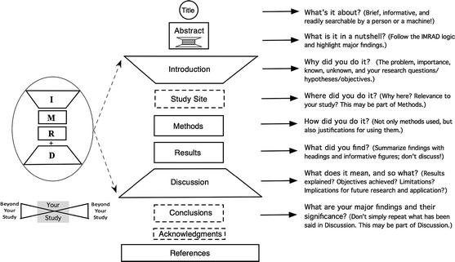
Recap on IMRAD method

Slide 4
Research Workflow
Design
Problem
Objectives
Data collection
Results
Discussion
Conclusion
Data analysis

Slide 5
Transparency
methodological transparency refers to “the degree of detail and disclosure about the specific steps, decisions, and judgment calls made during a scientific study”

Slide 6
Transparency
Entails clear reporting of design, sampling, analysis, uncertainty, limitation and ethics

Slide 7
Benefits of research transparency
Credibility
Reproducibility
Scientific Integrity
Trustworthiness

Slide 8
Objectives → Methods → Results
Objective | Data Collection | Analysis | Results
To determine flood exposure | Household survey | Descriptive statistics | Exposure percentages
To understand community perceptions | Interviews | Thematic analysis | Themes
To predict flood risk | GIS & Remote Sensing | Random Forest | Flood risk maps

Slide 9
Discuss more examples from participants

Slide 10
No results should be reported without corresponding method

Slide 11
Reporting results from quantitative methods
Present findings in the same order as described in Methods.
Descriptive Statistics
Means
Standard deviations
Frequencies
Percentages
Inferential Statistics
Include
Test statistic
Degrees of freedom
p-values
Confidence intervals
Effect size
Tables, Figures and Maps
Good visualizations should include:
Clear titles
Units
Legends
Sample size
Source
Numbering

Slide 12
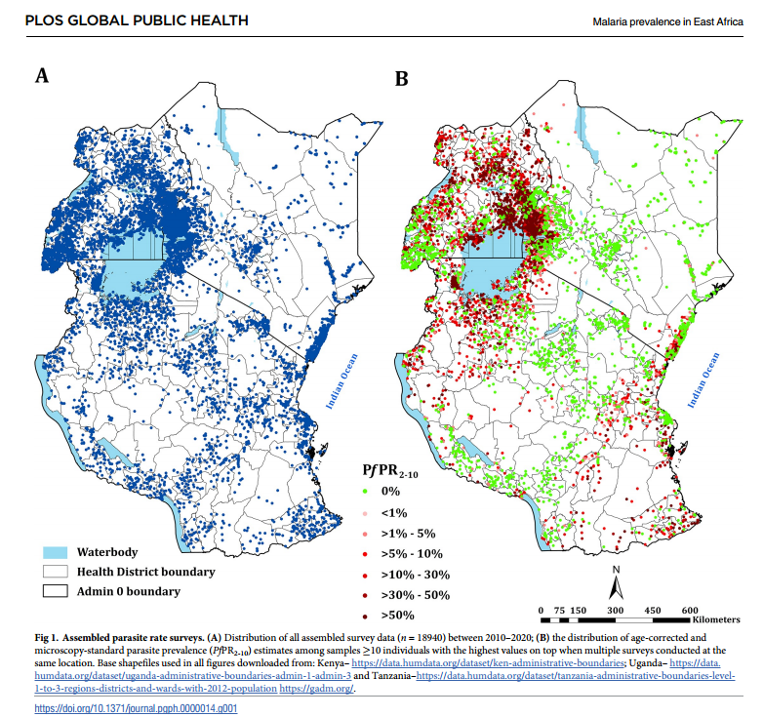
Using Maps to report results

Slide 13
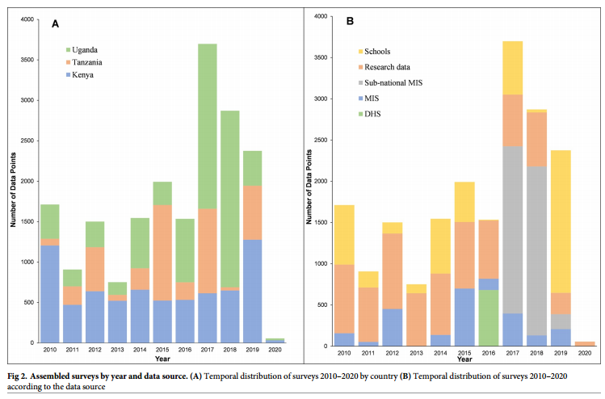
Using Charts to report results

Slide 14
Reporting results from qualitative methods
Present findings by theme
Theme 1: Limited Access to Climate Information
Quotation
"Flood warnings usually arrive after the flooding has already started."
Interpretation
Delayed communication increases household vulnerability.

Slide 15
Reporting results from mixed methods
Integrate quantitative and qualitative findings
Quantitative | Qualitative | Interpretation
72% flooded | Residents cited blocked drainage | Infrastructure contributes to flood risk
63% lacked insurance | Participants reported poverty | Financial vulnerability limits resilience

Slide 16
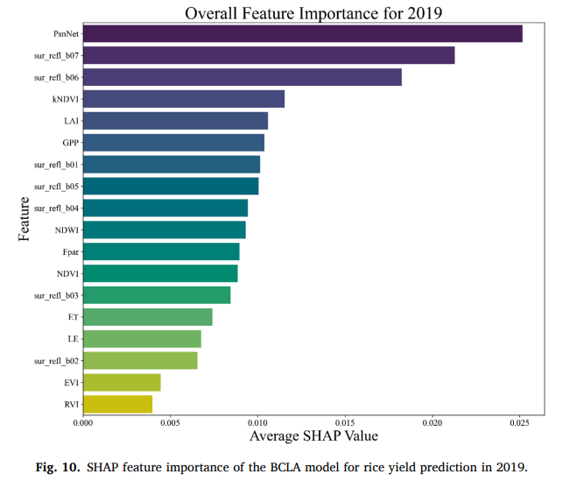
Reporting results from AI and GIS
For GIS studies report
Spatial resolution
Coordinate system
Classification algorithm
Accuracy assessment
Validation
For AI studies report
Model used
Hyperparameters
Feature selection
Accuracy
Precision
Recall
F1-score
Explainability

Slide 17
Mistakes
Best Practices
Reporting results not described in Methods
Introducing new variables
Mixing Results with Discussion
Too many quotations without analysis
Poor figure captions
Lack of uncertainty reporting
Every objective should have a corresponding method and results
Results should be presented in the same order of the methods
Use tables and figures effectively
Report uncertainty and limitations of the study

Slide 18
Questions and discussions

